Slide 1
Laptop Price Prediction
Guided By:- By:-
Prof. Dr. SUNIL KHILARI SWANAND S. DONGARE
Seat No.20055

Slide 2
Content
Introduction
Problem Statment
Requirment
Diagram
Screen(UI)
Future Work
Bibolography

Slide 3
Introduction
Artificial Intelligence is an integral part of all major e-commerce companies today. With the evolution of the information industry and extensive research in the field of AI in the past two decades, businesses have started to explore the ways to automate various activities using state of the art Machine Learning algorithms
In today’s digital world every-field accepting digitization for that every Work purpose or for learning purpose everyone needs laptop or desktop so that’s why while buying new laptop we failed to find perfect laptop with the actual ligit price so thats why this application will help to find out the actual price for our required specifications.

Slide 4
Problem Statment
Around 160 Million laptop sold every year so our target is to showcase the approx price for that particular specification of laptop and that is the reason why I have try to implement this to app help to people When we go to buy laptop in any e-commerce site or in a shop we can see the huge price difference so that's why this project will to predict tentative price for that specification
Predicting the price of the product is tough challenge since very similar product having minute difference such as different brand, different size many more so that's its very difficult to predict the exact price of laptop

Slide 5
Requirements
Software Resource:
Operating system : Windows 7 and above.
Coding Language :Python
IDE : Jupyter notebook, Visual Studio Code
Hardware Resource:
System : Intel I3 Processor and above.
Hard Disk : 200 GB.
Monitor : 15 VGA Color.
Ram : 4 GB.

Slide 6
Dataset Design
Table Name:- Laptop Data
Description:-In this Dataset there are total 14 columns
Primary Key:- Sr.No

Slide 7
Laptop Dataset
Field Name | DataType | Size | Description
Sr.No | Int | 30 | Primary key
Company | Varchar | 10 | Company Name
TypeName | Varchar | 10 | Diff Types of Laptop
Ram | int | 5 | Ram size
Weight | Float | 10 | Weight of Laptop
Price | Float | 10 | Price of Laptop
Touchscreen | Int | 10 | convert in Boolean
Ips | Int | 10 | Boolean true or false
Ppi | Float | 20 | resolution of laptop
Cpu Brand | Varchar | 10 | cpu brand name
HDD | Int | 10 | Storage type and size
SSD | Int | 10 | Storage type and size
Gpu Brand | Varchar | 20 | Gpu brand name
Os | Varchar | 20 | OS type

Slide 8
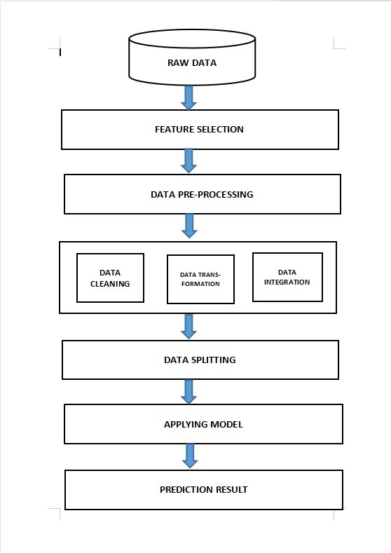
Diagrams
System Design

Slide 9
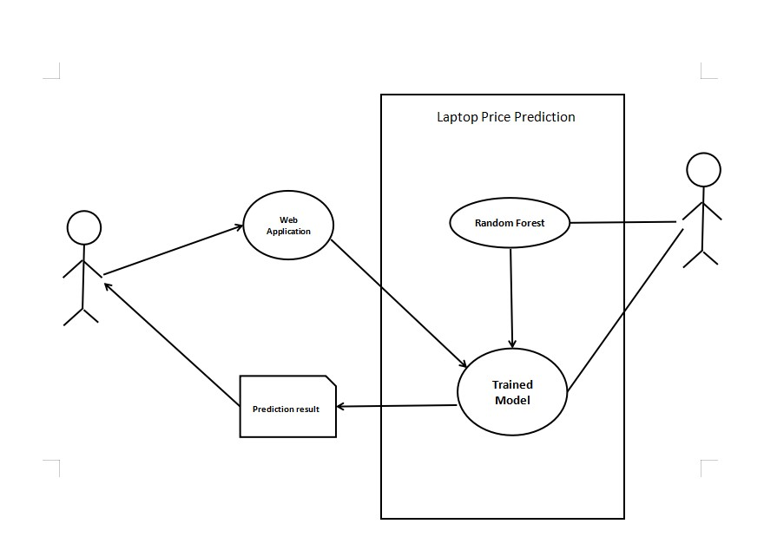
Use Case Diagram For System

Slide 10
Use case name | Laptop Price Prediction
Actor | User,Admin
Precondition | User must have filled all correct specification
Main flow | a)Fill all fields correctly b)Data will go via pip-line c) System apply machine learning modelingd)Trained the model e)Collect data f)Predict Price
Output | Predict Price of Laptop

Slide 11
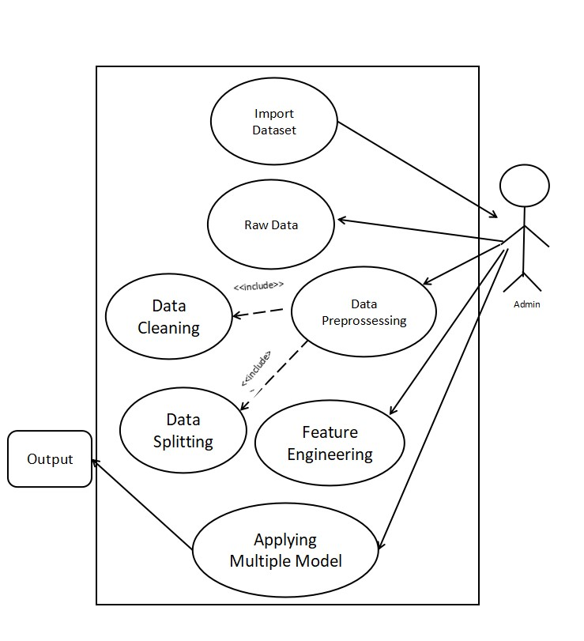
Use Case for Admin

Slide 12
Use case name | Use Case Admin
Actor | Admin
Description | The Use case describe the role of admin
Pre-Condition | User must be put correct specification
Main flow | Import data b)Raw Data c) Data Processing d)Data Cleaning e)Feature Engineering f)Data Splitting in Test Split and Train Split g)Applying Model h) Predict
Output | Predicted Successfully

Slide 13
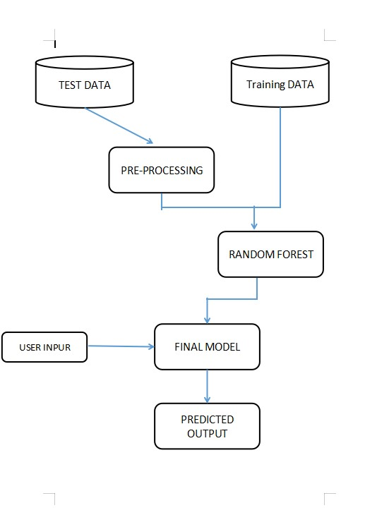
Activity Diagram

Slide 14
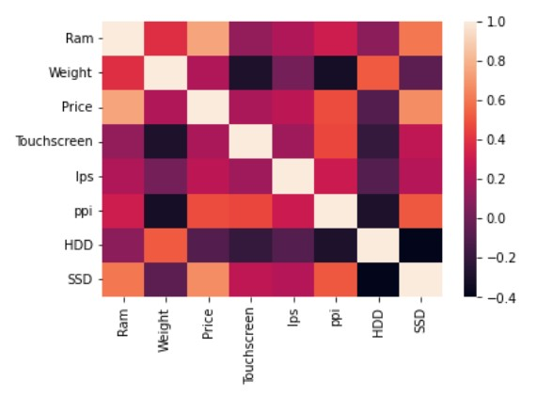
Correlation

Slide 15
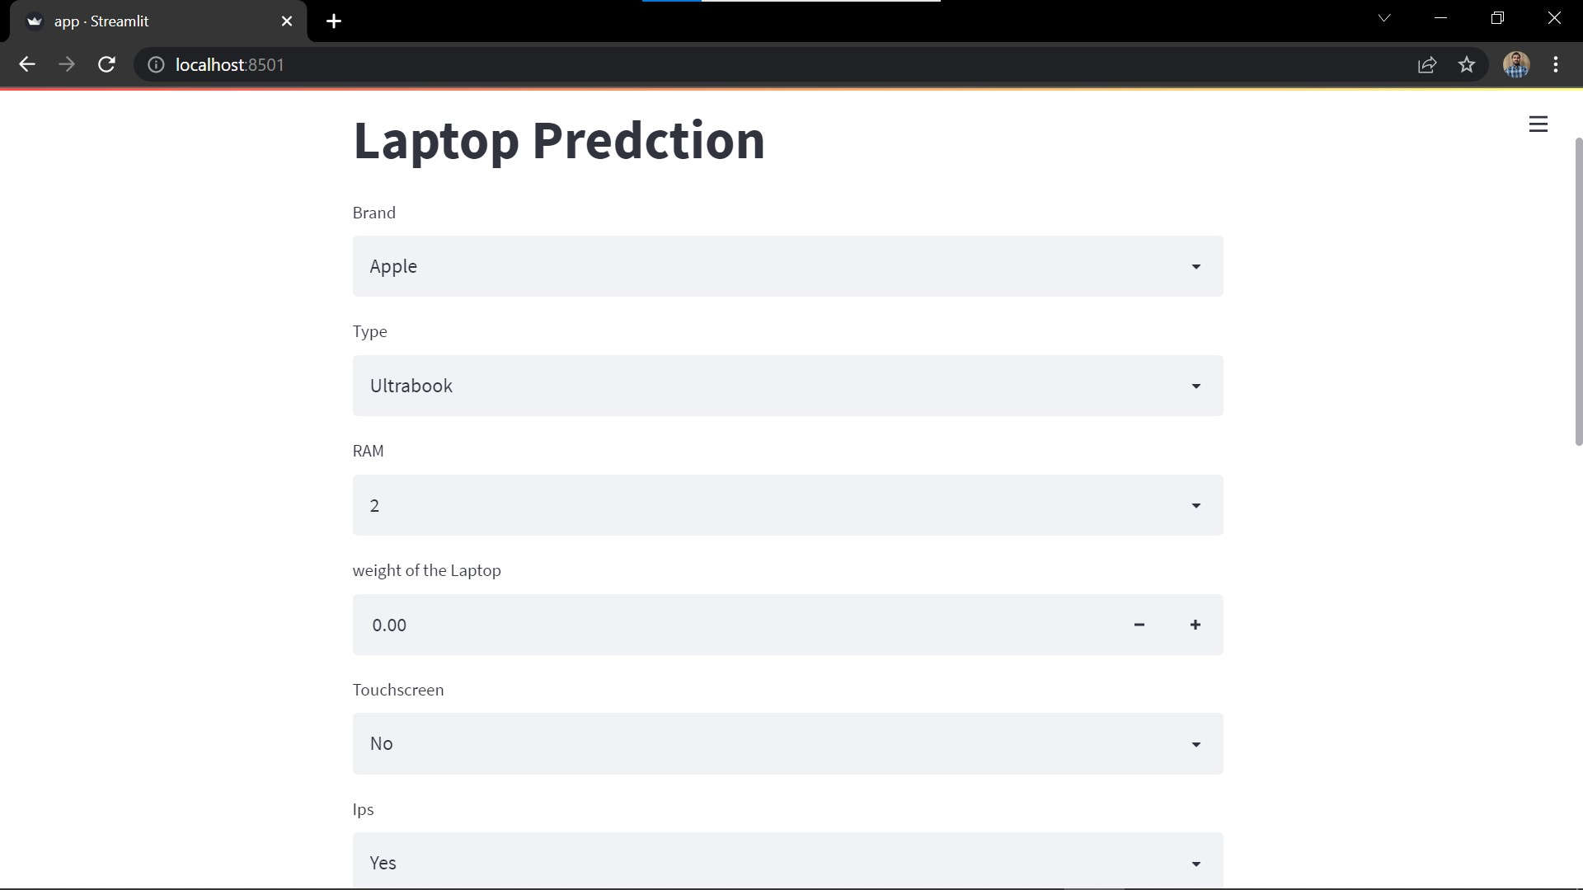
Outputs
Home Page

Slide 16
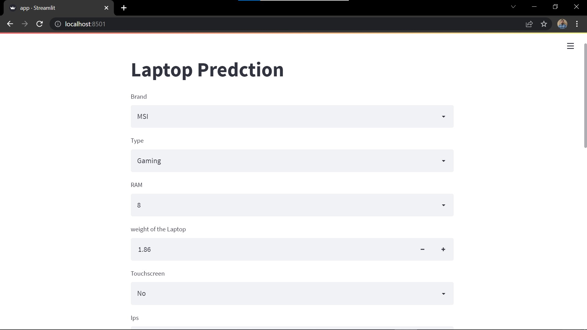
Outputs
Input Form

Slide 17
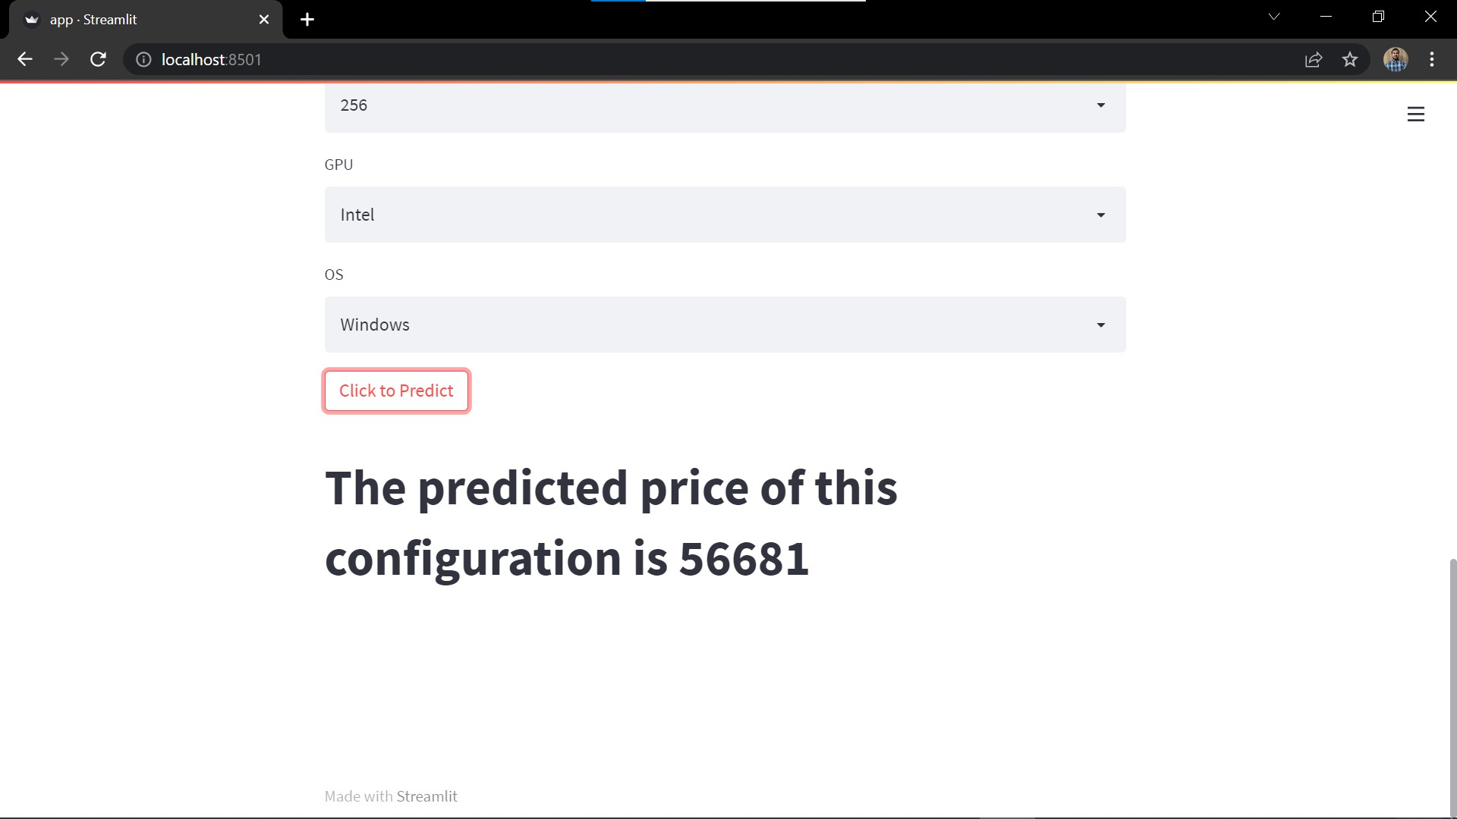
Outputs
Predicted Output

Slide 18
Future Work
There are several research directions for future work. First, it might be interesting to think about other recent Machine learning models, like XGBoost any many other learning, to create prediction models. The modal can be extended for recommendation system accordingly predicted the price. But this model has disadvantages also because of the Laptop price also fluctuate because of the new technology and new updates this can cause our model Fails

Slide 19
Bibliography
www.Google.com
www.Researchgate.net
www.Builtin.com
www.simplilearn.com

Slide 20
Thank you

